Slide 1


Slide 2

What is Wireshark?
Contents
Introduction
Exploring wireshark

Slide 3
What is Wireshark?
Wireshark is a network packet/Protocol Analyzer.
Formerly known as Ethereal
Open source packet analyzer-UNIX, Windows
www.wireshark.org
Packet analyzers
Capture traffic
Decodes raw data
Analyzes each packet based on protocols within it
Common Packet Analyzers:
Wireshark
tcpdump

Slide 4
pcap files
Packet Capture
Files containing raw network traffic
Generally have a “.pcap” extension

Slide 5
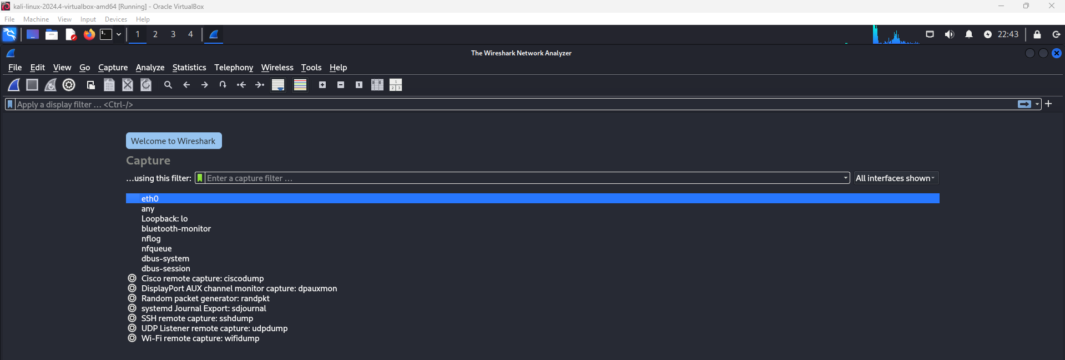

Slide 6
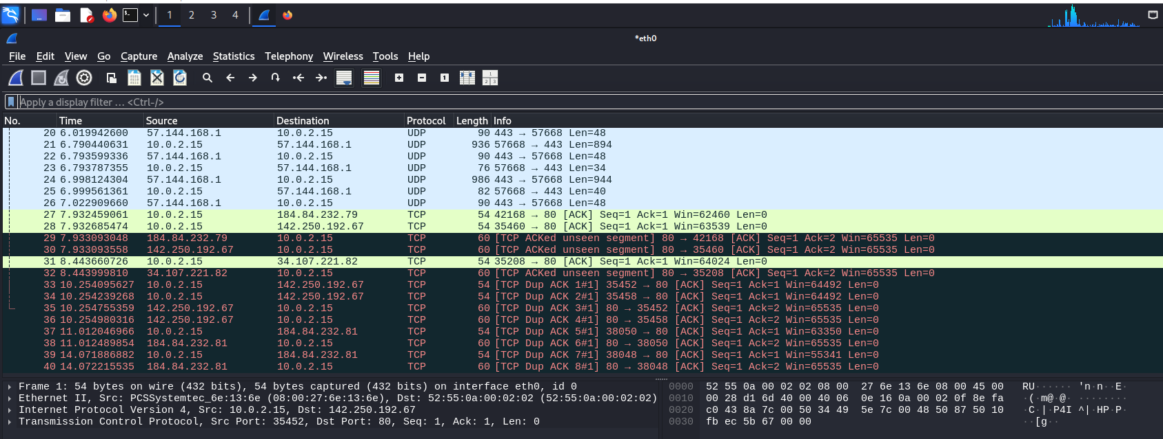

Slide 7
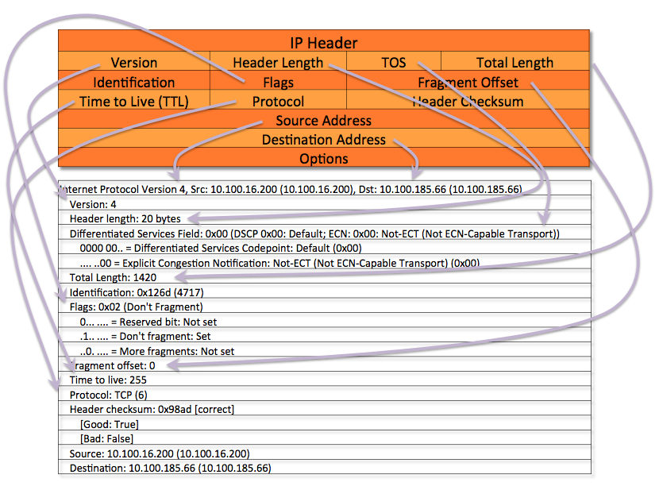

Slide 8
Here's an overview of the major tabs and their functions:
File:
Used for managing files.
You can open, save, or close capture files here.
It also includes options for importing and exporting files, printing packets, and setting up preferences.
Edit:
This tab provides functions for modifying settings and preferences within Wireshark.
You can undo/redo actions, find specific packets, or copy data to the clipboard for further analysis.
It also includes options to configure capture filters and preferences for packet display.
View:
This tab focuses on changing how data is displayed within the Wireshark interface.
Include the ability to toggle various panes (like packet list, packet details, and packet bytes) and zoom in/out.
You can also adjust layout preferences and enable/disable the toolbar.
Go:
Provides options to navigate through your capture data.
You can jump to specific packets, set a time reference, or go to the next or previous packet matching certain criteria.
Capture:
Contains the controls for starting and stopping packet capture.
You can begin a new capture session, pause or stop capturing, and configure the capture settings (like selecting network interfaces, applying capture filters, etc.).

Slide 9
Analyze:
Analysis tools to help you interpret captured packets.
Features include:
Follow TCP Stream: View the entire conversation of a particular TCP stream.
Expert Information: Shows protocol anomalies and errors in the capture data.
Resolve Name: Resolve IP addresses to hostnames.
Statistics:
Contains various statistical analysis tools for your capture data, such as:
Summary: Gives you a high-level overview of the capture (like the number of packets and protocols).
Protocol Hierarchy: Displays the distribution of protocols in your capture.
Packet Lengths: Shows packet size distributions.
IO Graphs: Provides graphical representations of traffic over time.
Endpoints: Displays network endpoints (IP addresses and ports).
Conversations: Shows communication pairs (source/destination) and their data flow.
Telephony:
Analyzing network traffic related to telephony protocols, such as SIP, RTP, and other voice communication protocols.
It provides call and media stream information, such as RTP stream analysis and signaling information.
Tools: miscellaneous tools for various tasks.
Includes utilities for DNS resolution, packet dissection, and troubleshooting network issues.
Help: Wireshark's documentation and support resources.

Slide 10
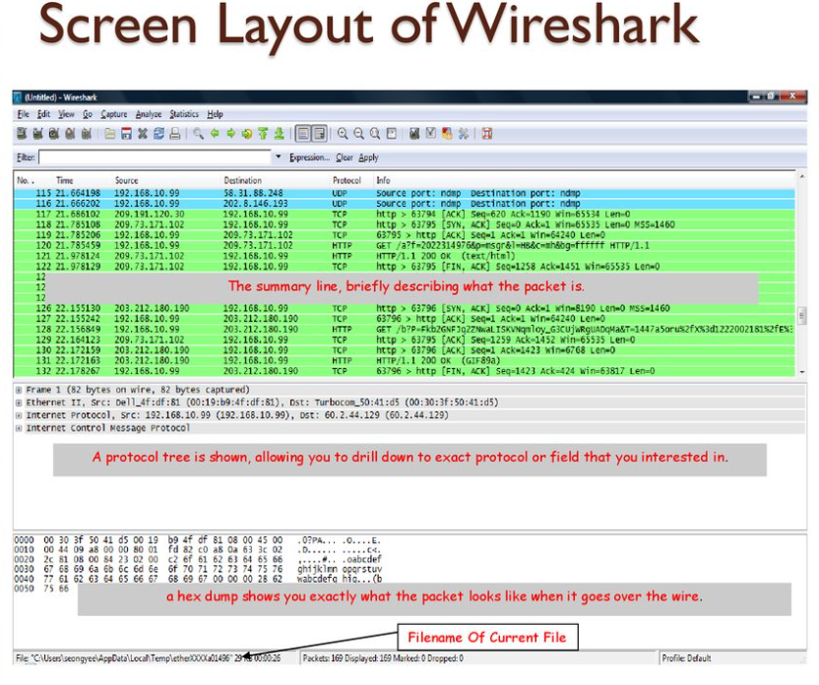

Slide 11
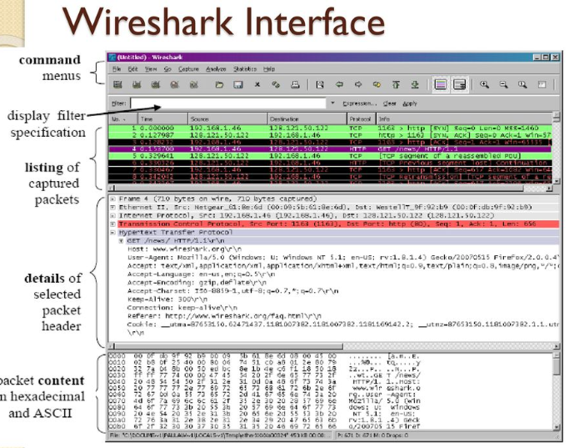

Slide 12
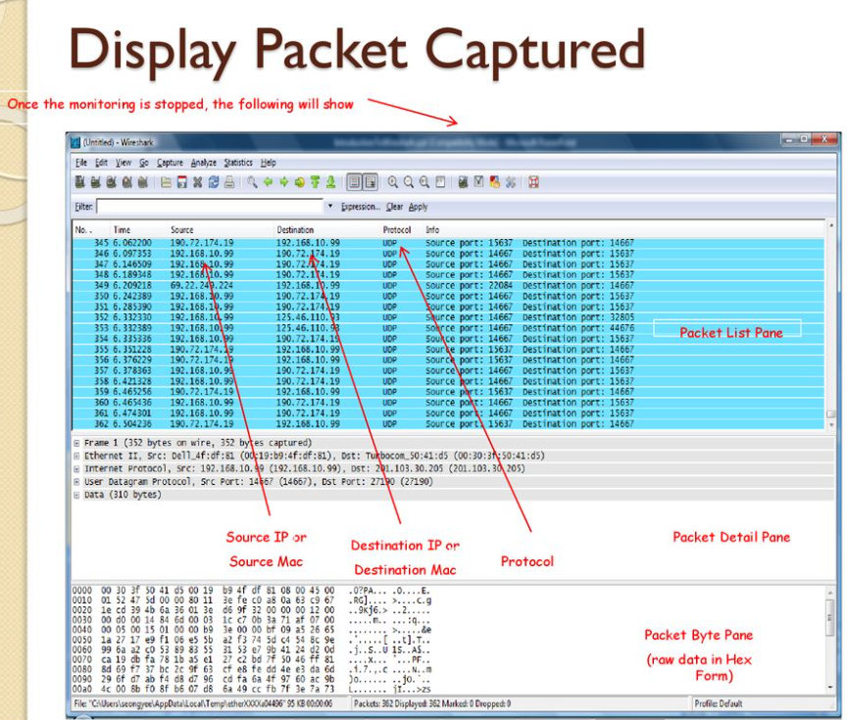

Slide 13
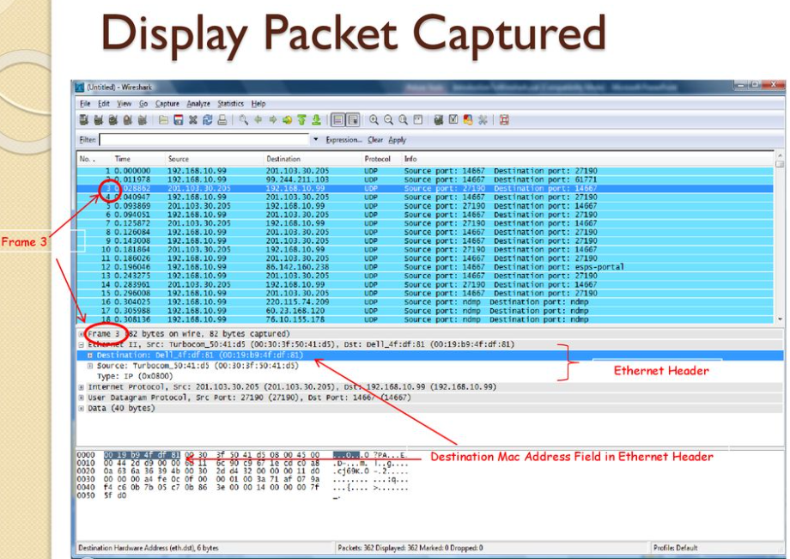

Slide 14
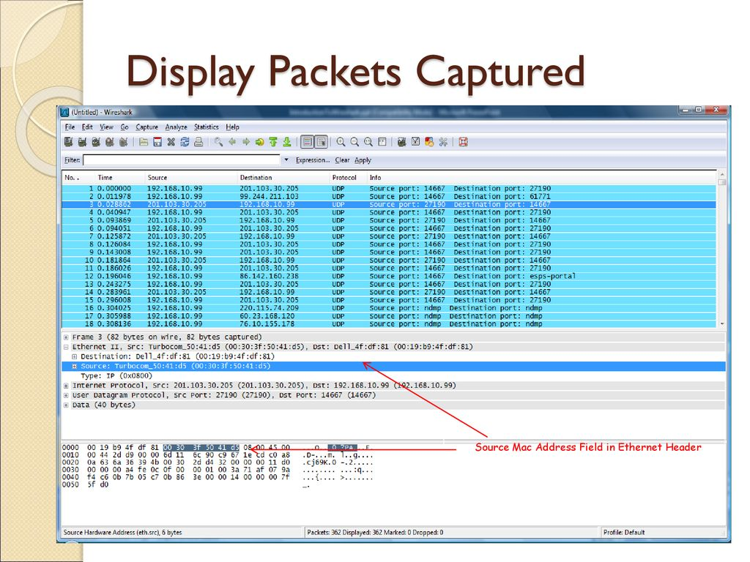

Slide 15
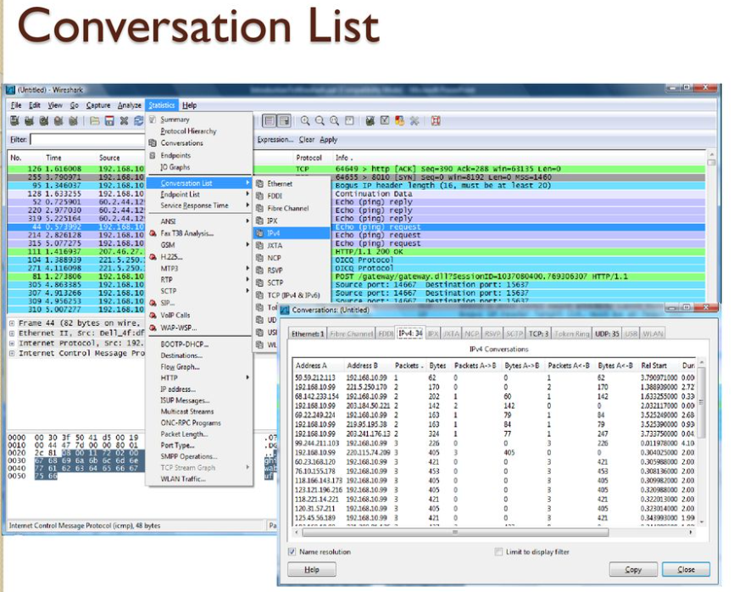

Slide 16
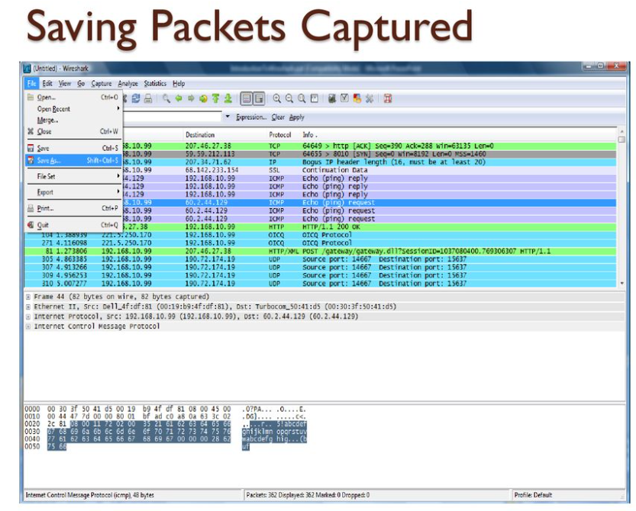

Slide 17
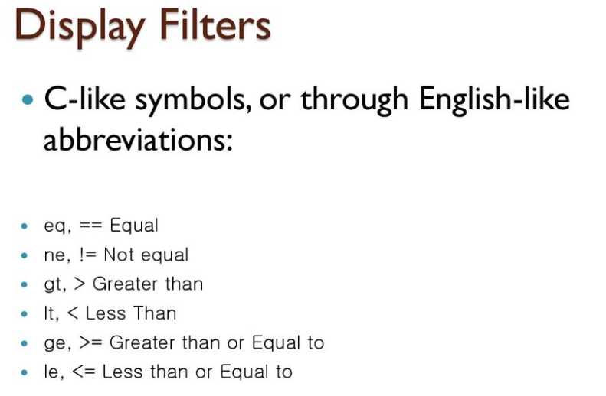

Slide 18
1. Protocol-Based Filters
http: Filters HTTP packets.
tcp: Filters TCP packets.
udp: Filters UDP packets.
icmp: Filters ICMP packets (for example, ping requests and replies).
dns: Filters DNS packets.
arp: Filters ARP packets.
ip: Filters IPv4 packets.
ipv6: Filters IPv6 packets.
ssl / tls: Filters SSL/TLS traffic (for encrypted communication).

Slide 19
2. IP Address-Based Filters
ip.addr == 192.168.1.1: Filters packets where the IP address is either the source or destination (192.168.1.1 in this example).
ip.src == 192.168.1.1: Filters packets where the source IP is 192.168.1.1.
ip.dst == 192.168.1.1: Filters packets where the destination IP is 192.168.1.1.
ipv6.addr == 2001:0db8:85a3:0000:0000:8a2e:0370:7334: Filters IPv6 packets by address.

Slide 20
3. Port-Based Filters
tcp.port == 80: Filters TCP packets that involve port 80 (HTTP).
udp.port == 53: Filters UDP packets that involve port 53 (DNS).
tcp.srcport == 443: Filters TCP packets with source port 443 (typically HTTPS).
tcp.dstport == 443: Filters TCP packets with destination port 443.

Slide 21
4. Flags-Based Filters
tcp.flags.syn == 1: Filters TCP packets with the SYN flag set (used for establishing a connection).
tcp.flags.fin == 1: Filters TCP packets with the FIN flag set (indicating the termination of a connection).
tcp.flags.reset == 1: Filters TCP packets with the RST flag set (resetting a connection).
tcp.flags.push == 1: Filters TCP packets with the PUSH flag set.

Slide 22
5. Packet Length Filters
frame.len == 128: Filters packets that are exactly 128 bytes long.
frame.len > 1000: Filters packets larger than 1000 bytes.
frame.len < 500: Filters packets smaller than 500 bytes.

Slide 23
6. Time-Based Filters
frame.time > "2025-03-10 12:00:00": Filters packets captured after a specific time.
frame.time <= "2025-03-10 12:00:00": Filters packets captured on or before a specific time.

Slide 24
7. Field-Based Filters
http.request.uri contains "login": Filters HTTP packets that contain the string "login" in the request URI.
ip.ttl == 64: Filters packets with a Time-to-Live (TTL) value of 64.
dns.qry.name == "example.com": Filters DNS query packets for the domain "example.com".
icmp.type == 8: Filters ICMP Echo Request packets (ping requests).
icmp.code == 0: Filters ICMP Echo Reply packets (ping replies).

Slide 25
8. Error or Anomaly-Based Filters
tcp.analysis.retransmission: Filters retransmitted TCP packets.
tcp.analysis.out_of_order: Filters out-of-order TCP packets.
tcp.analysis.fast_retransmission: Filters fast retransmissions in TCP.
http.response.code == 404: Filters HTTP responses with a status code of 404 (Not Found).

Slide 26
9. Combination Filters
You can combine multiple conditions using logical operators like && (AND), || (OR), and ! (NOT):
ip.src == 192.168.1.1 && tcp.dstport == 443: Filters packets with source IP 192.168.1.1 and destination port 443 (HTTPS).
ip.addr == 192.168.1.1 || ip.addr == 192.168.1.2: Filters packets where the IP address is either 192.168.1.1 or 192.168.1.2.
tcp.flags.syn == 1 && tcp.flags.ack == 1: Filters TCP packets with both SYN and ACK flags set (used in the TCP handshake).

Slide 27
10. Advanced Filters
frame contains "password": Filters any packets that contain the string "password".
tcp.analysis.ack_rtt: Filters TCP packets to analyze round-trip time (RTT) for acknowledgment.
ssl.record.version == 0x0303: Filters SSL/TLS packets with version 1.2.
frame.time_relative >= 5: Filters packets with a relative timestamp of 5 seconds or more.

